Slide 1

POISON
REMNANT

Slide 2
POISON
REMNANT
THE DEVELOPER TEAM
Samantha Heisterkamp, Database Administrator
Chad Rousseau, Scrum Master
Ken Pederson, Repo Owner
OVERVIEW
Methodologies
Application Demonstration
Remaining Challenges
Lessons Learned

Slide 3
POISON
REMNANT
Methodologies
Ken Pederson
OVERVIEW
Agile
Trello
Wiring Diagram
README

Slide 4
POISON
REMNANT
Methodologies
AGILE
Planning
Executing
Evaluating

Slide 5
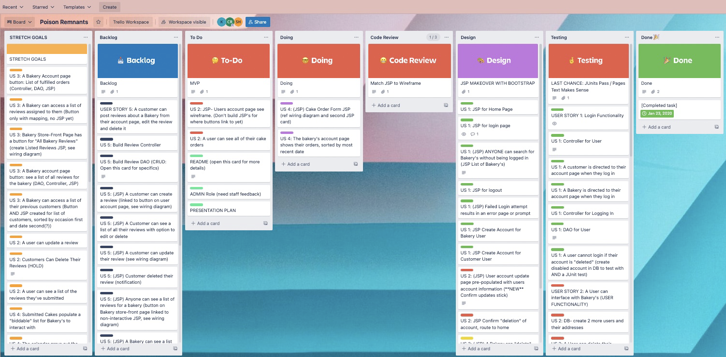
POISON
REMNANT

Slide 6
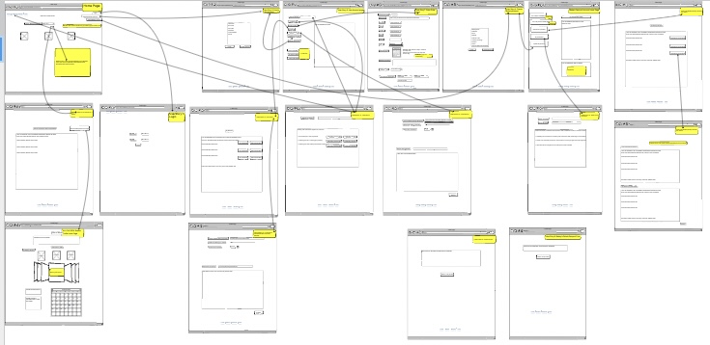
POISON
REMNANT

Slide 7
POISON
REMNANT
POISON REMNANT README

Slide 8
POISON
REMNANT
Application Demonstration
Samantha Heisterkamp

Slide 9
POISON
REMNANT
Remaining Challenges
Chad Rousseau
OVERVIEW
Bidding Capabilities
Customer Reviews & Bakery Responses

Slide 10
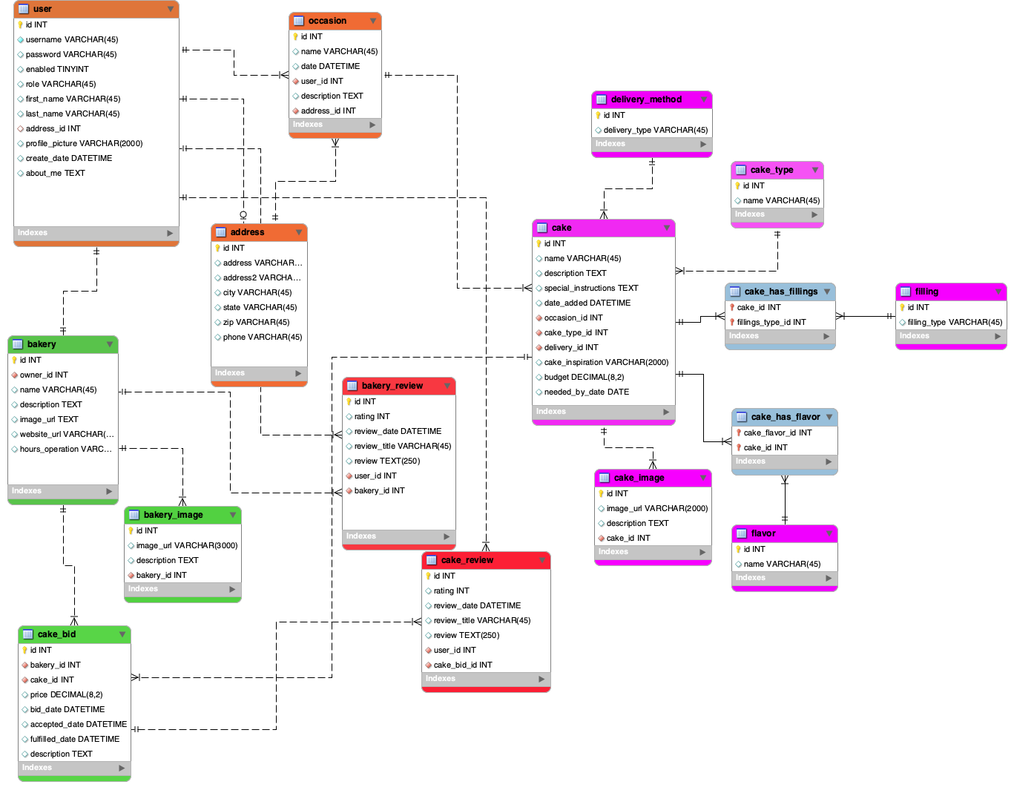
POISON
REMNANT

Slide 11
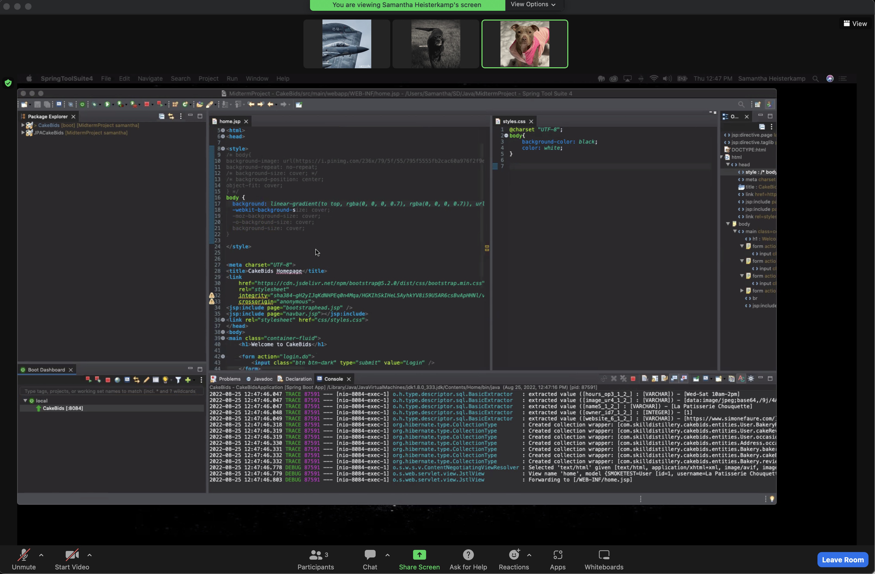
POISON
REMNANT
Lessons Learned
Poison Remnant

Slide 12
POISON
REMNANT
Review
Methodologies
Application Demonstration
Remaining Challenges
Lessons Learned

Slide 13
POISON
REMNANT
Questions

